Slide 1

CASE STUDY
Submitted by,
Sri Hari R M

Slide 2
Methodology used → CRISP-DM structure
Data Understanding
Data Modelling
Model Evaluation
6745 unique requests for 5 days
Status of the requests provided
Data from and to Airports is given
Time stamp is converted to date time format as a part of preparation
Visualizing the data by plotting various graphs of requests vs. time slot, trip status and location based charts
Evaluate the most pressing problems of Uber
Identify gap between supply and demand
Ways to solve demand gap

Slide 3

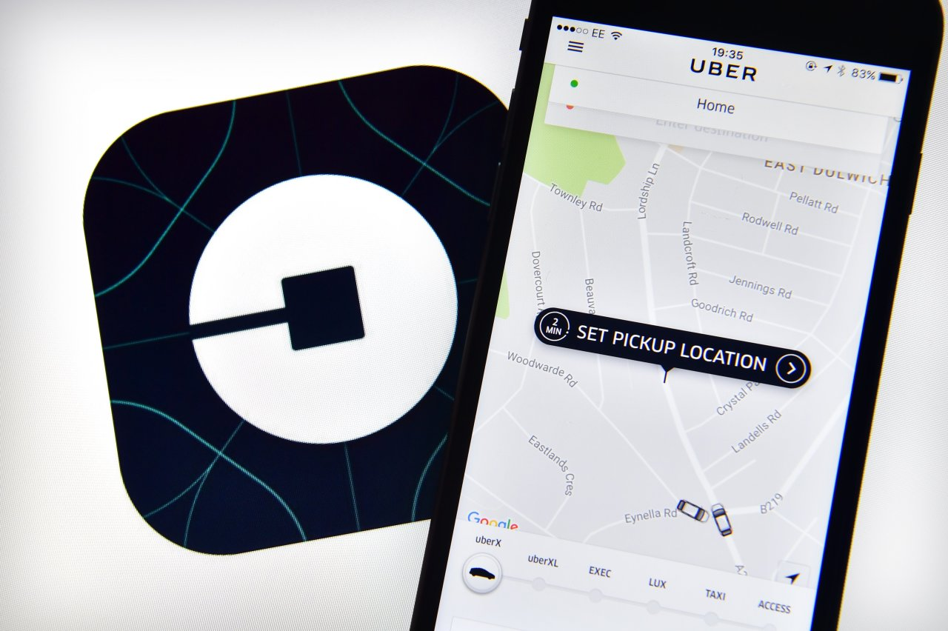
PROBLEM STATEMENT
Find out the supply demand gap
Suggest ways to improve the situation

Slide 4
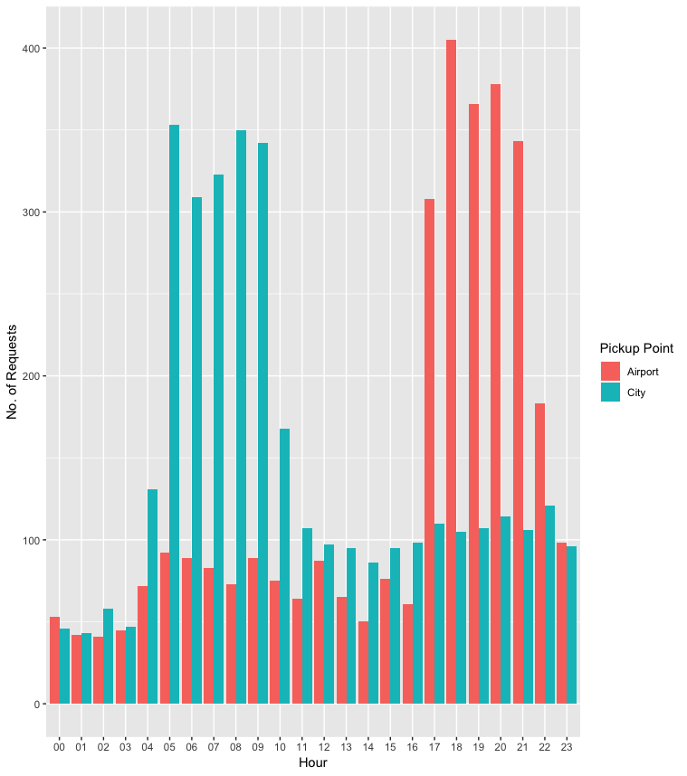
Analyzing the data by Requests in a day based on locations
It clearly depicts that number of requests are more in the city area during the day time
Number of requests are higher from the airport during the late evening and night time

Slide 5
CONSIDERING TO HAVE 5 SLOTS IN A DAY
Binning the time to different slots for analysing the demand
TIME | SLOT
12AM– 5AM | Early Morning
5AM – 10AM | Morning
10AM – 5PM | Mid Day
5PM – 10PM | Late evening
10PM – 12AM | Night

Slide 6
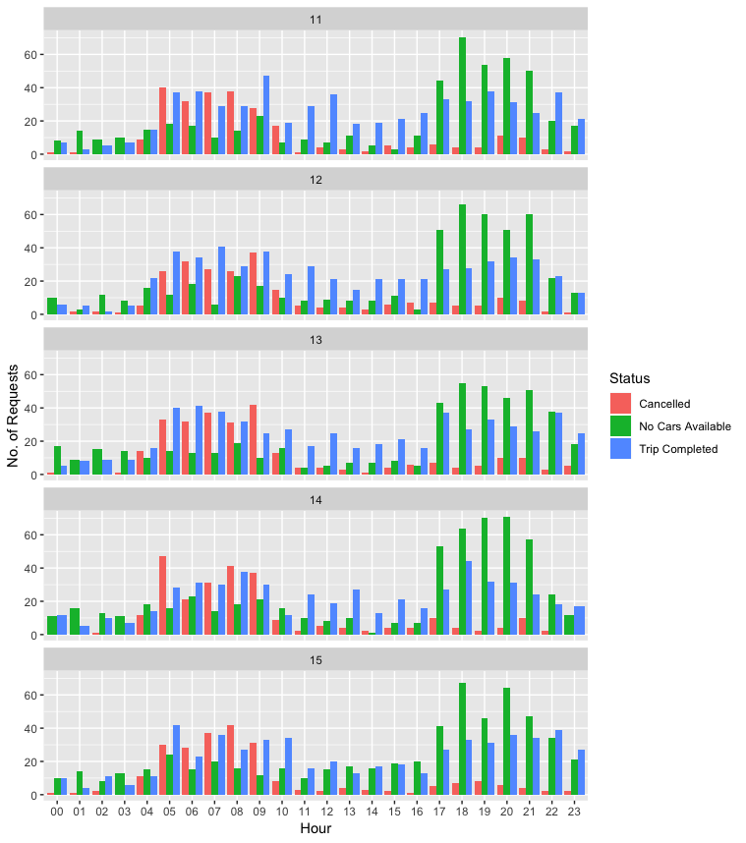
Deeper analysis of requests
High cancellation during the morning times
Unavailability of cars during the late evenings and night times
Common pattern on all the days

Slide 7
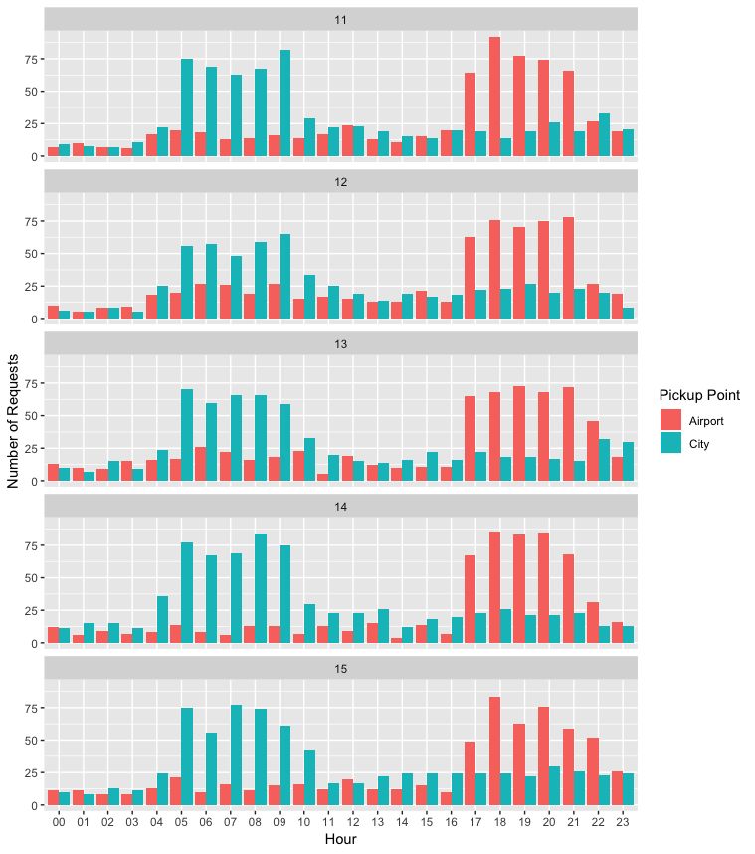
Deeper analysis of requests based on pickup point
More number of requests from the city in the morning time
Demand for cars is higher in the evening and night time from airport region
Trend continues to be same on all the days

Slide 8
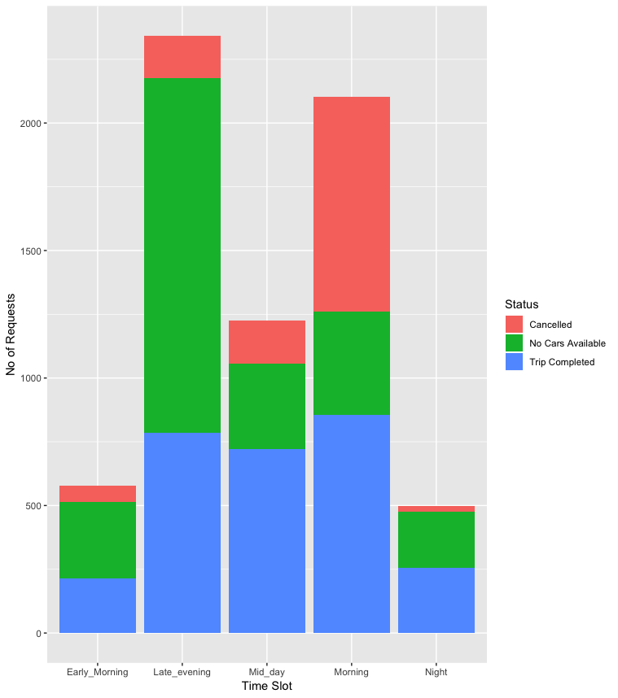
PROBLEM IDENTIFIED
Requests are high both during morning and evening times.
Cancellation is high in morning while there are no cars available during evening!

Slide 9
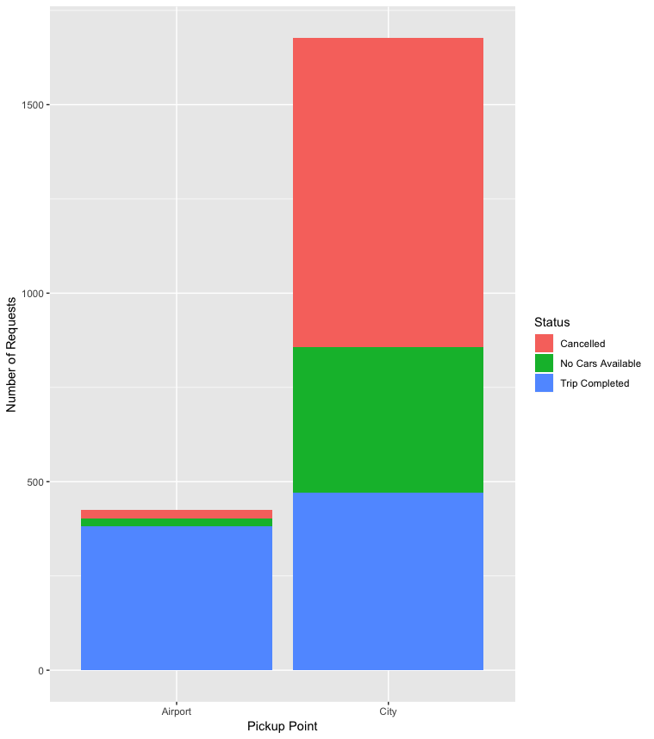
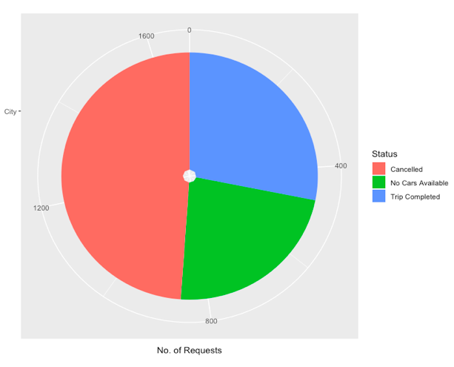
ANALYSING CANCELLED TRIPS DURING MORNING
Pickup point | No of requests Cancelled
Airport | 23
City | 820
City Requests!
49%
28%
23%
HUGE DEFFERENCE BETWEEN SUPPLY AND DEMAND IN THE CITY DURING MORNING TIMES!

Slide 10
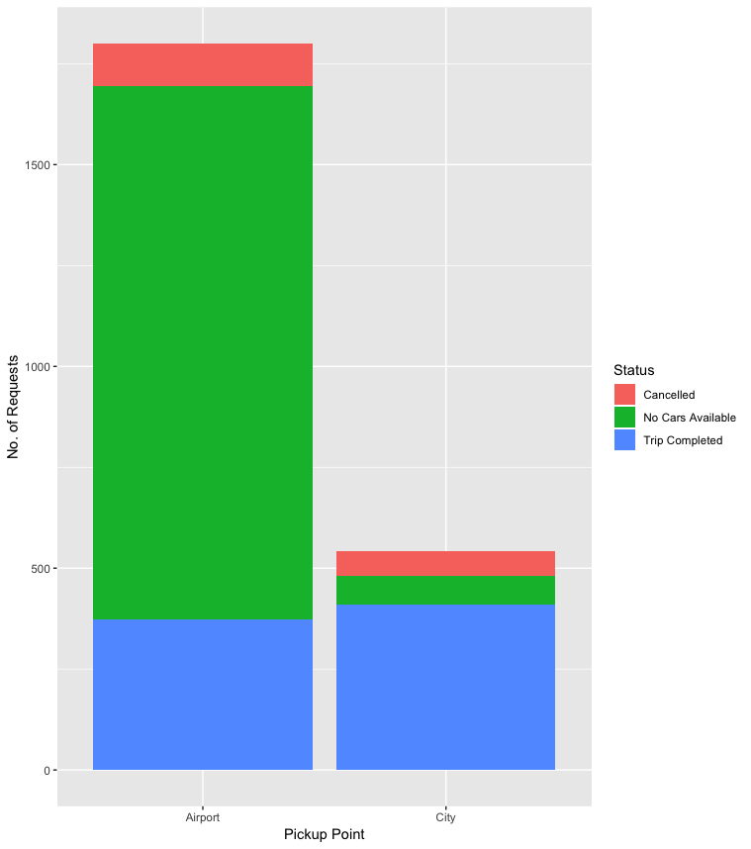
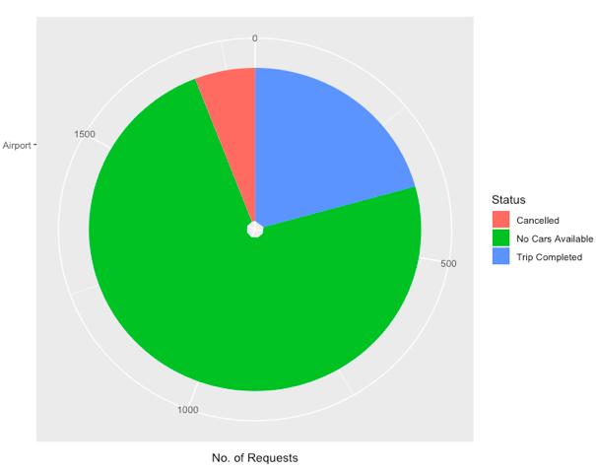
ANALYSING UNAVAILABILITY OF CARS DURING EVENING
Pickup point | Unavailability Requests
Airport | 1321
City | 71
Airport Requests!
6%
21%
73%
HUGE DEFFERENCE BETWEEN SUPPLY AND DEMAND IN THE AIRPORT DURING EVENING TIMES!

Slide 11

OUTCOME OF ANALYSIS
EVENING TIMES IN AIRPORT
DEMAND
SUPPLY
MORNING TIMES IN CITY

Slide 12


WANT BIG IMPACT?
USE BIG IMAGE.

Slide 13
RESOLUTION
Solution for Problem 1: High cancellation in the city during morning times
Since the drop off point is airport, drivers tend to skip the trip by making short hauls. This can be improvised by providing additional benefits such as ‘airport duty incentives’ and ‘road toll waiver’
Additionally, setting a limit for drivers in cancelling the requests would definitely bring a positive effect and reduce the number of cancellation
Further, adding of new cars for airport duty alone would meet the demand effectively
Solution for Problem 2: Unavailability of cars during the evenings in airport region
As mentioned above, adding cars for airport duty alone can meet the demand as the numbers of cars available is less.
Another way to reduce the idle time is that, by lowering the prices during the idle time
Paying for the fuel cost, when drivers have to return empty from the airport.

Slide 14

THANKS!
Image courtesy: Google

